Slide 1
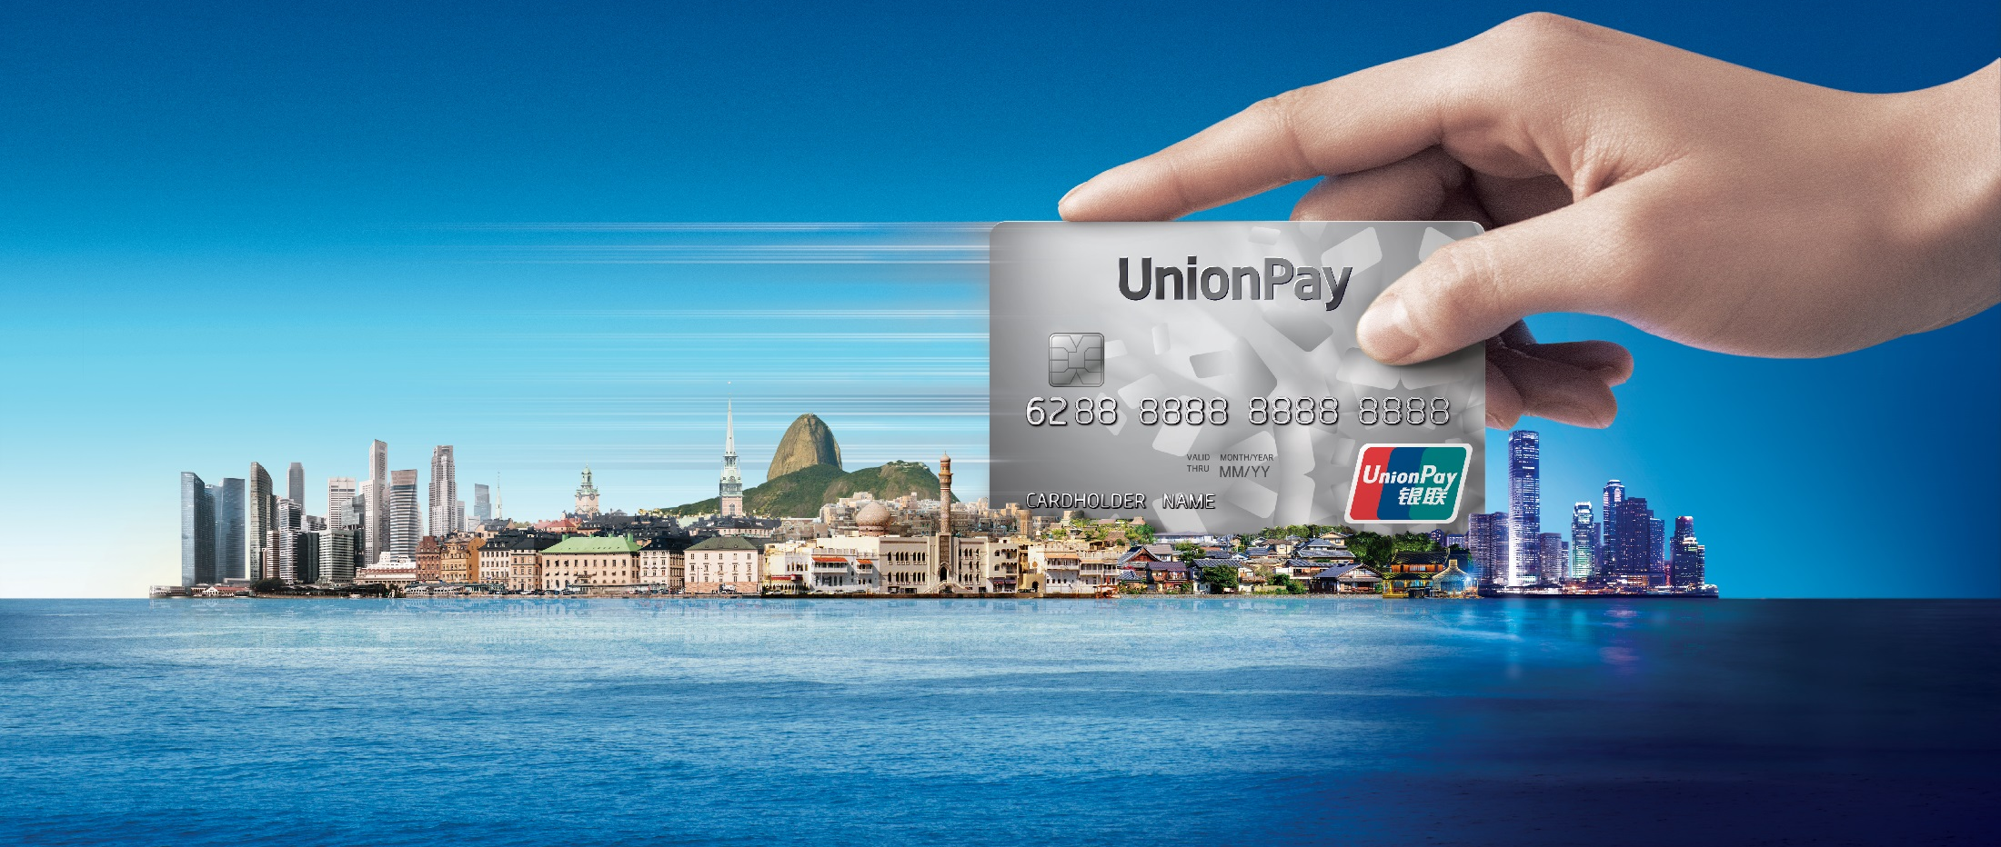


UPI QR Code Payment

Slide 2
The contents shared in this presentation are provided "AS IS" and intended for informational purposes only and should not be relied upon for operational, marketing, legal, technical, tax, financial or other advice. It is intended to be used between UnionPay International and the parties with whom the content is shared; it cannot be distributed nor shared with any other parties. All material mentioned in this presentation is to facilitate discussion between both parties and will not be deemed as an agreement. Assumptions were made by us in light of our experience and our perceptions of historical trends, current conditions and expected future developments and other factors that we believe are appropriate under the circumstance. Recommendations are subject to risks and uncertainties, which may cause actual and future results and trends to differ materially from the assumptions or recommendations. UnionPay International is not responsible for your use of the information contained herein (including errors, omissions, inaccuracy, formatting errors or non-timeliness of any kind) or any assumptions or conclusions you might draw from its use.

Slide 3
Contents
What Is UPI QR Code Payment
Why Is UPI QR Code Payment
How To Cooperate
UPI QR Code Status Quo
Notes:
This presentation will consist of 4 parts, and this is the agenda that we are going to base on today.
The first section is the general introduction of QR Code payment and UPI Solution. In this section, a brief summary will be given of why people or consumer and merchants would like to use QR Code payment
Following we will explain why UPI QR Code payment should be adopted. You will be presented the benefits and valus of our QR Code product
Then a short view of working model to implement UPI QR Code for our partners
In the end we will illustrate the status quo on UnionPay QR Code business in mainland China and international market.

Slide 4
01
What Is UPI QR Code Payment

Slide 5
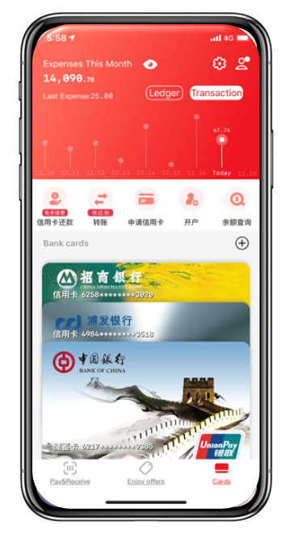
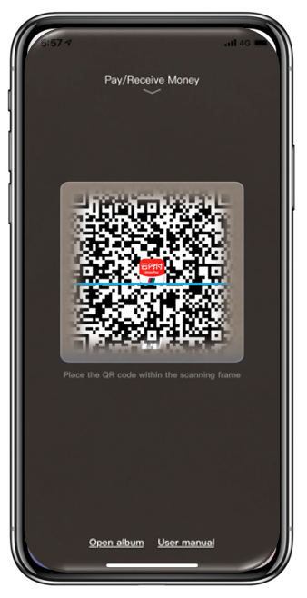
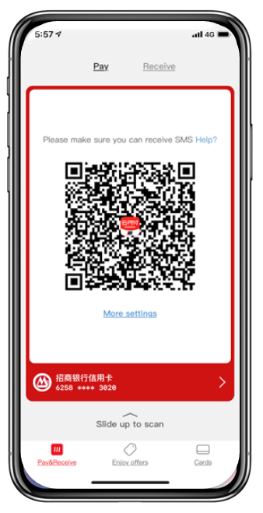
UPI QR Code Payment
Notes:
The is how UPI QR Code works in a Mobile Wallet and how UnionPay APP actually looks like.
UPI QR Code payment solution, first of all, supports both merchant-presented and consumer-presented mode. Under merchant-presented mode, this solution also supports both static and dynamic Merchant QR Code from Merchant side.
For merchant presented mode, consumer click “scan” and open the camera to scan merchant QR Code;
For consumer presented mode, consumer click “Pay” and display a QR Code for merchant scan it.

Slide 6
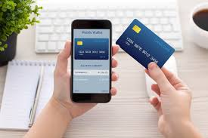
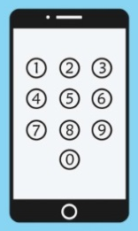
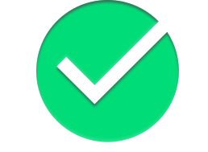
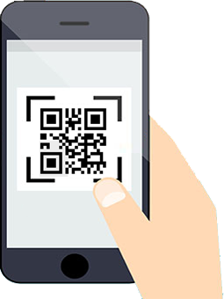
UPI QR Code Merchant-Presented
UnionPay card-provision for first-time use (cardholder set APP PIN)
Cardholder scans merchant QR Code
Cardholder confirms transaction amount and APP CVM
Transaction completed with transaction notification
Thank You
You have made a payment
*1. Enter APP CVM (PIN, Finger or Face ID) for each transaction
Notes:
For merchant presented mode, after binding the card into mobile wallet, cardholders can open the camera through the mobile wallet APP to scan the QR Code displayed by the merchant to initiate the QR Code transaction.
For each transaction, cardholders need to enter APP PIN or relevant CVM to submit the transaction.

Slide 7
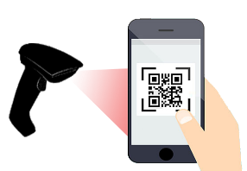
UPI QR Code Consumer-Presented
UnionPay card-provision for first-time use (cardholder set APP PIN)
Generate payment QR Code in Consumer APP
Merchant scans QR Code*
Transaction completed. Merchant and cardholder receive notifications
Thank You
You have made a payment
* 1. No CVM required for low-value payment;
2. APP CVM (not card PIN) is required for large value payment
Notes:
For consumer presented mode, after binding the card into mobile wallet, cardholders can generate the QR Code on the wallet app, and let cashier to scan it. The merchant thus initiate the QR Code transaction.
When excessing the no-PIN limit, cardholders need to enter APP PIN or relevant CVM to proceed the transaction.

Slide 8

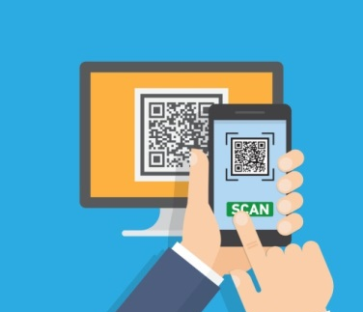

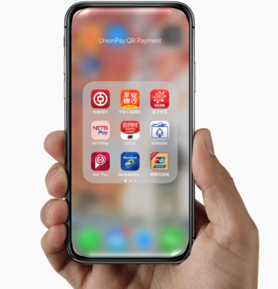
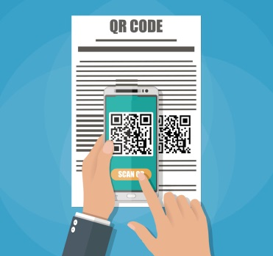
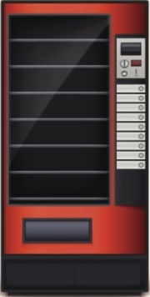
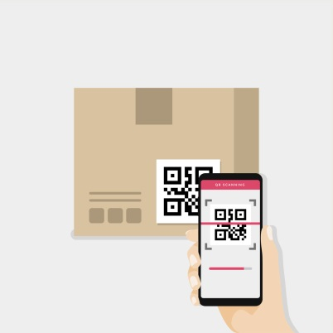
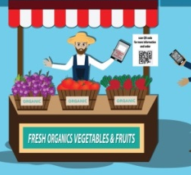
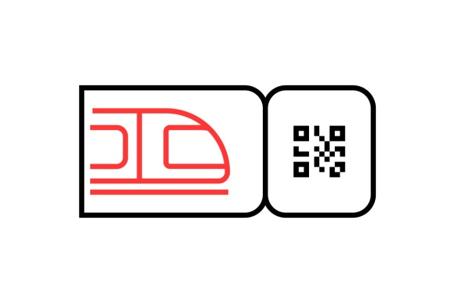
UPI QR Code Payment Scenarios
Notes:
We would like to provide a consistent and convenient user experience for UnionPay cardholders among different payment scenarios, including food courts, farmers market, delivery, public transportation, taxi, vending machine, and online payment, etc.
The ideal example is that whenever cardholders want to make a purchase, such as buying a bottle drink from vending machine or place an order online, cardholder can do exactly same simple things: take out the mobile phone, scan or present a QR Code, and enter PIN when necessary, and transaction is completed.

Slide 9
02
Why is UPI QR Code Payment

Slide 10


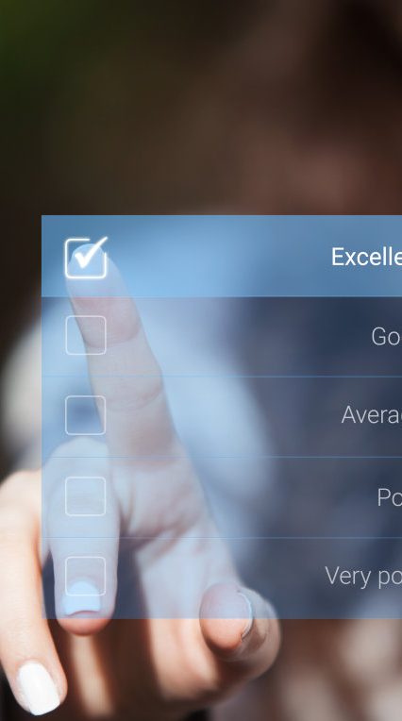

Why UPI QR Code Payment
Security
Auxiliary
Services
0
Flexible
Implementation
Low Cost
Notes:
A cost effective payment solution for cardholders and merchants
A secure payment solution to ensure global standardization and interoperability
A convenient payment solution to link transactions to bank or merchants marketing promotions and value-added services.
A flexible solution that can be deployed and implemented based on partners various demands.

Slide 11
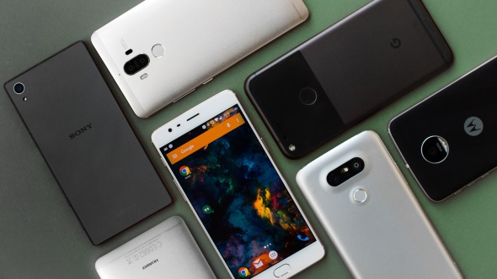
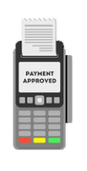

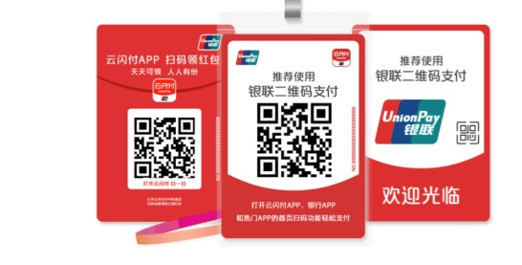
Low-cost Payment Solution
Require much less hardware purchases and investments
Cardholder Reliance
Merchant Investment
Works on any smart phone
with screen and camera
（Android/ iOS）
Merchant-
Presented mode
Consumer -Presented mode
Reapply existing facilities
Integrate QR Code reader
Install Merchant APP
Smart POS Terminal
A static QR Code
Dynamic QR Code
printed on ticket
displayed on smart devices
Notes:
For cardholders, UPI QR Code can be generated or scanned on any smart phone with screen and camera, and operated on any mobile OS platform. Cardholders don’t need a certain or specific mobile phone or system or an mobile APP to conduct UPI QR Code Payment.
For merchants, under consumer-presented, merchant can work it out through integrating QR Code scanner with existing cashier facilities, or install Cashier APP on any smart devices; under merchant-presented, merchant can simply print out a static QR Code and stick to the cashier counter, or generate dynamic QR Code on merchant APP.

Slide 12

Secure Payment Solution
Various risk-control measures & Explicit liability allocation
EMVCo - compatible to ensure global standardization, worldwide interoperability and aggregation
CDCVM evolved from PIN or signature for better cardholder’s authentication & verification method
Enhanced security with Tokenization
Avoid exposure risk of card information or account confidentiality
Less vulnerable to web attacks (e.g. URL spoofing, or phishing)
New participant of APP Provider for real-time transaction monitoring
Less chargeback risk to Acquirer
Notes:
The entire UPI QR Code Payment solution is complaint with EMVCo standard and specification. For merchants, all participated payment brand and schemes can be integrated into one QR Code; and for cardholder, any mobile wallet product can make QR Code payment on UPI QR Code merchant worldwide, and cardholder verification has upgraded to CDCVM such as Finger ID and Face ID.
QR Code transaction is transited with tokenization to protect exposure risk of cardholder confidential information, and EMVCo standard QR Code protects web attacks without URL included.
For UPI QR Code, we also introduced a new participant, APP Provider, to make sure corresponding risks and liabilities are clearly allocated. E.g., since cardholders verification is undertook by mobile wallet from APP Provider, instead of by merchant terminals in traditional POS transaction, some charge back risk will be transferred to APP Provider.

Slide 13
Complete Auxiliary Services
For Issuer/ Cardholder
White-label Wallet product
“QR Code + UPlan Coupon” in one-step payment
QRC +
UPLAN
For Acquirer/ Merchant
Reduce system modification
Free merchant APP
Free management platform
Merchant Gateway
Service
Notes:
Related supporting services and tools will be provided to issuing side and acquiring side if requested.
For issuer, UPI has a while-label wallet solution for issuer to launch their own-brand wallet product with functions and modules of UPI Mobile Payment. And cardholder can enjoy “QR Code Payment + U Plan Discount” in one step on all UPI Merchants support both QR Code and Uplan acceptance.
For acquirer and merchants, we offer UPI QR Code Merchant Gateway Service Platform for merchant connect to UPI directly. Thereby acquirer does not have to do too much system modification, and release this product to market in a very short time.

Slide 14
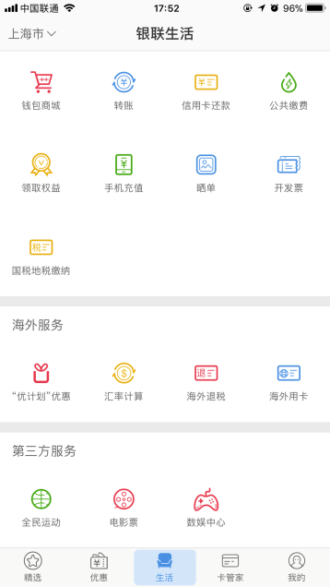
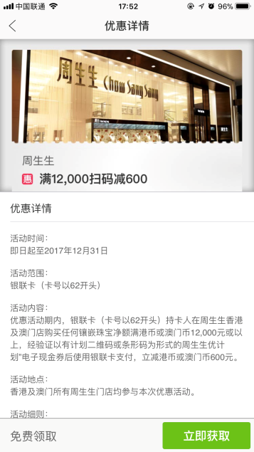
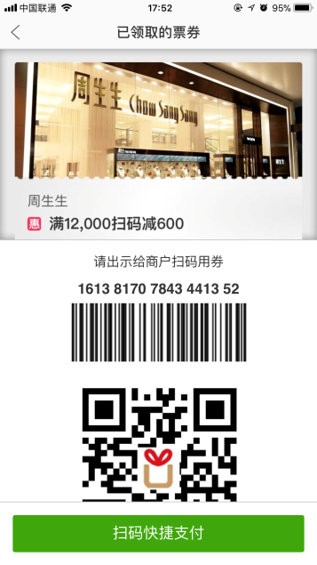
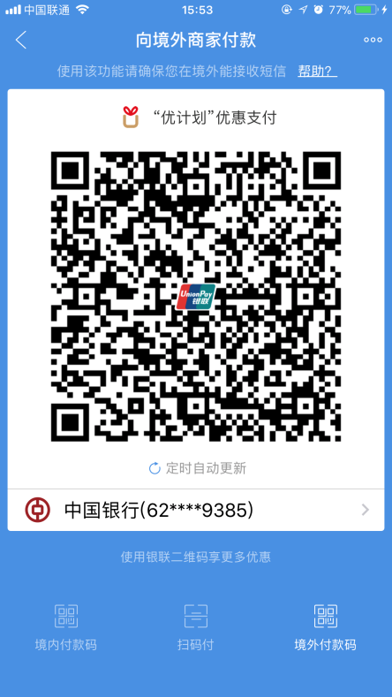
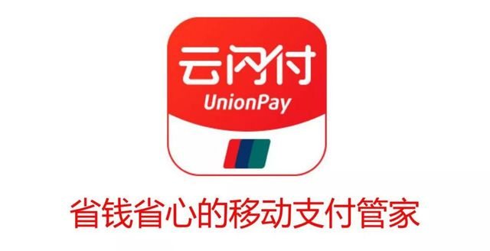
Services For Issuer/Cardholder
White-label solution offers one-time integration to enhance payment experiences together with promotions, loyalty programs or other value-added services
STEP 1
STEP 2
STEP 3
STEP 4
STEP 5
Open an APP that supports UPLAN
Click UPLAN module
Claim the coupon
Click Pay by QR Code
Present payment QR Code including discount Info.
Notes:
For cardholders, they can make QR Code payment with UPLAN discount information included in the code.
Under Consumer-presented mode, UPLAN cardholders can complete “QRC Payment + UPLAN Coupon” in one step.
Under Merchant-presented mode, cardholders initiate payment with APP, and system automatically matches the best discount after cardholders claim the coupon.
The workflow explain how the “Payment + Coupon” operates step by step.
It provides discount to cardholders, but it also provides promotion of the merchants to consumers and attract more transactions.

Slide 15
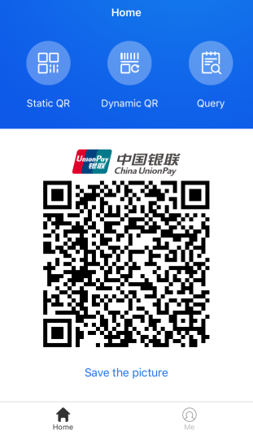
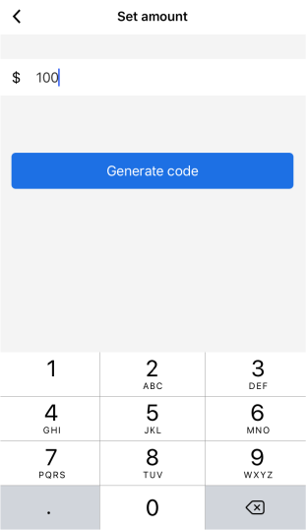
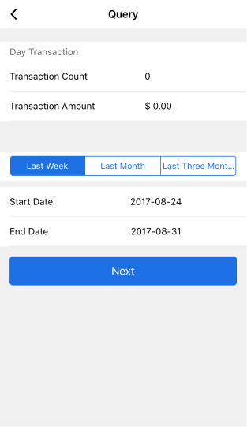
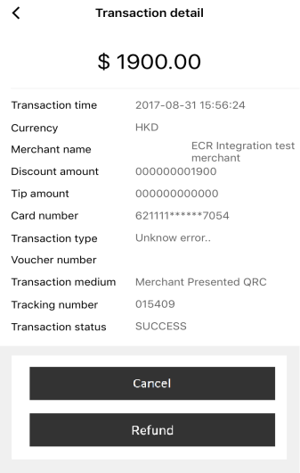

Services For Acquirer/Merchant
QR Code Merchant Gateway Service Platform to provide Web-based Portal for merchant management and Merchant APP
Gateway
Platform
No SYS. development
No service fee
Shorter time to market
No certification test
Secure solution
Merchant APP
Static
QRC
Dynamic
QRC
Transaction
Inquiry
Cancellation & Refund
Notes:
For merchants, UPI QR Code offer Direct-Connect Merchant Service Platform.
Under this mode, merchants are directly connected to UnionPay, and UPI will help generate the QR Code for merchants through Merchant APP. The acquirer will not participate in the transaction, but UPI will send out the settlement file to acquirers in the end.
With this webpage, acquirers can log in and manage merchants and terminal in batch, more like a back-end of merchant service platform.
After acquirers generate merchant information through this website, merchant can start using UPI merchant APP to conduct QR Code payment.

Slide 16

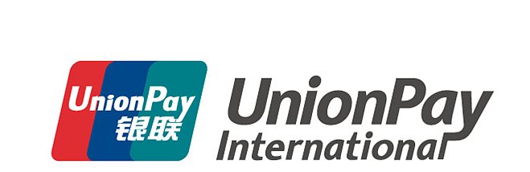

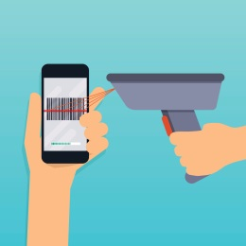
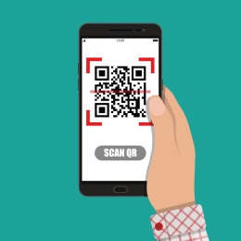
Flexible Implementation
Issuers
Acquirers
APP Dev.
Integrated
Modular
Host System
Account Verf.
QRC TRX.
UP APP
Format
ISO 8583
JSON
Connection
Indirect
Direct
Notes:
UPI offers different cooperation strategy with QR Code acquirer and issuer. Issuer can support pure QR Code transaction on issuing host system, or they can create a mobile wallet product as an APP Provider as well.
Acquirers can choose between ISO 8583 and JSON for message format, MPM and CPM according to their preferences, or even direct mode without any system modifications.

Slide 17
03
How To Cooperate?

Slide 18



How to Work for QR Code Acquirer
QR Code
Acquirer
Apply UPI QR Code acquiring license
TPSP
Cooperate with UPI existing acquirer for system or terminal work
Payment
Facilitator
Endorsed by UPI existing acquirer
Notes:
Membership and license are a big first step for acquirer to cooperate with UPI about QR Code business.
There are two categories of membership, independent QR Code acquiring license or TPSP as a system or operation vendor. Within TPSP, there is new category of Payment Facilitator to conduct UPI business directly as long as the institute is endorsed by an Acquirer.

Slide 19
How to Work for QR Code Acquirer
Membership
Application
System Development
& Modification
Testing Environment Verification
System &
Business Launch
Documents Obtain
QR Code Encoding Spec.
Technical Spec. of Online Message
Implementation Guide
Test Case
Communication & Connection
Leased Line: ISO 8583
URL Access: JSON message
Direct-Connection
Production Environment Configuration
QR Code
Acquirer
Apply UPI QR Code acquiring license
Payment
Facilitator
Endorsed by UPI existing acquirer
Notes:
This is normal procedure from Membership Application to final Product Launch.

Slide 20
How to Work for QR Code Issuer
UnionPay Issuer
Existing issuer apply for Wallet ID
New issuer apply for Issuing License and Wallet ID
Third-party APP Provider
Endorsement from existing UnionPay Issuer
Application of Wallet ID
TPSP
Cooperate with UPI existing acquirer for system or terminal work
QR Code
Acquirer
Apply UPI QR Code acquiring license
Payment
Facilitator
Endorsed by UPI existing acquirer
Notes:
Two types of cooperation on the issuing side.
As UPI QR Code issuer, issuing license is required, and Issuer should apply a wallet ID for the mobile wallet APP;
As a third-party APP provider, they can simply apply for a wallet ID but endorsement of an UPI Issuer is required.

Slide 21
How to Work for QR Code Issuer
Membership/Wallet ID
Application
System Development
& Modification
Testing Environment Verification
System &
Business Launch
Documents Obtain
QR Code Encoding Spec.
Technical Spec. of Online Message
Implementation Guide
Test Case
Communication & Connection
For Issuer: ISO 8583
For APP Provider: JSON message
Production Environment Configuration
QR Code
Acquirer
Apply UPI QR Code acquiring license
Payment
Facilitator
Endorsed by UPI existing acquirer
Notes:
This is normal procedure from Issuing Membership Application (including Wallet ID) to final Product Launch.

Slide 22
04
UPI QR Code Status Quo

Slide 23
UnionPay APP
A unified mobile payment traffic portal consolidate resources and channels of UnionPay and major commercial banks of mainland China
Wallet Product of Banking Industry
Registered accounts – 200 M+
Monthly active users – 40 M+ (by Dec. 2018)
Current Support to UnionPay QR Code
16M Merchants
200+ Acquirers
170+ Apps (17 main banks and 110+ regional banks)
Convenient Financial Services
Application of Bank Account and mobile NFC Pay
Multifunction - Bank Account Inquiry, Credit Card Payment, Tax Refund
Multi-scenario - Bill Payment, Toll Payment, On-campus Payment etc.
Notes:
This is a introduction of UnionPay APP, a mobile wallet product designed and developed by China UnionPay. And below are some current situation of how this UnionPay APP goes so far and the current situation of UnionPay QR Code in mainland China.

Slide 24
UnionPay QR Code in Overseas
From Oct.2017, 99 Acquirers from 31 countries & regions accept UPI QR Code
23 mobile wallet from HK, Singapore, Thailand, Vietnam, etc.
More than 300,000 QR Code Merchant among South Korea, Japan, HK/Macau, Thailand, Singapore, Malaysia, Africa etc.
Notes:
This is how UnionPay QR Code has developed so far in international market.

Slide 25
UnionPay QR Code in Overseas
Canada
Japan
the Unites States
South Korea
Nepal/ MTB
Pakistan
UAE
Vietnam/ Thailand
Panama
HK/Macau/Taiwan
Kenya
Singapore
Malaysia
Mauritius
Australia
 | Deployed | Potential
Iss. | 23 | 40+
Acq. | 99 | 30+
New Zealand

Slide 26
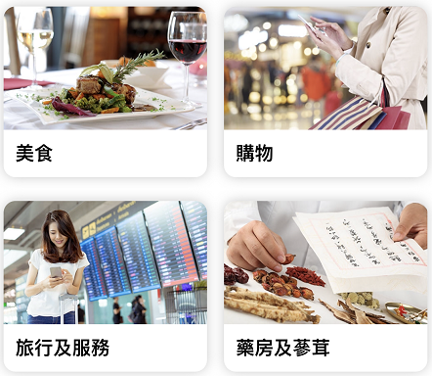
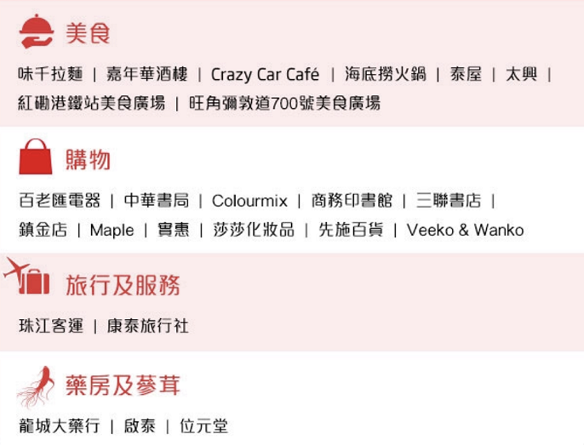

UnionPay QR Code in HK
Restaurants: Ajisen Noodles / Haidilao Hotpot / Thai Cuisine / Cantonese Cuisine / Delicacy Plaza etc.
Shopping: Electrical Appliance / Bookstore / Medical & Cosmetics / Department Store etc.
Restaurants
Shopping
Travels and Services: Chu Kong Shipping / Hong Thai Travel Service
Pharmacy & Herbs: Lung Shing Dispensary / Kaitai / Wai Yuen Tong
Travel
Service
Pharmacy
& Herbs

Slide 27



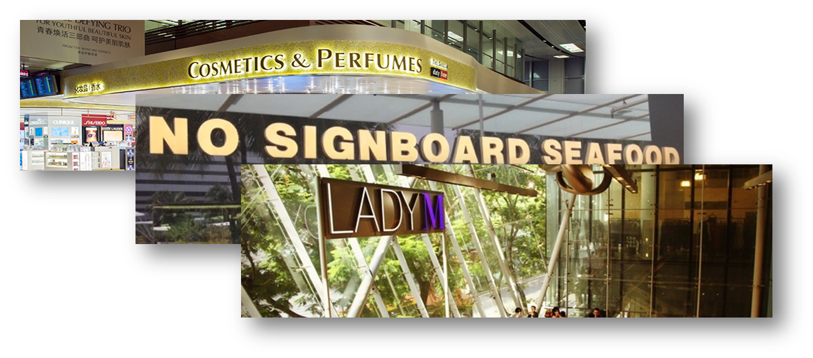
UnionPay QR Code in SEA
Notes:
Fine collection of merchants including duty free, fashions, restaurants, desserts

Slide 28








UnionPay QR Code in South Korea
Notes:
Duty free and shopping mall located in the largest commercial area Myeongdong in Seoul, and Airport, etc.
CU – popular convenience store in Korea

Slide 29
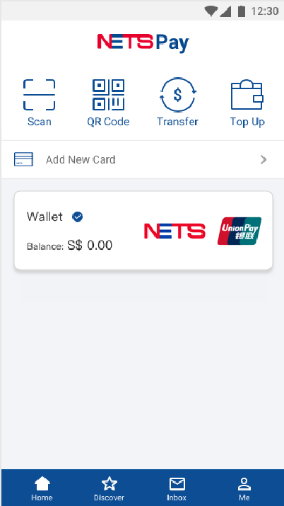
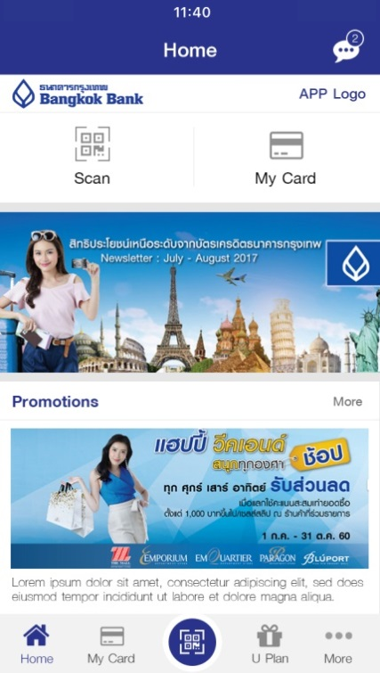
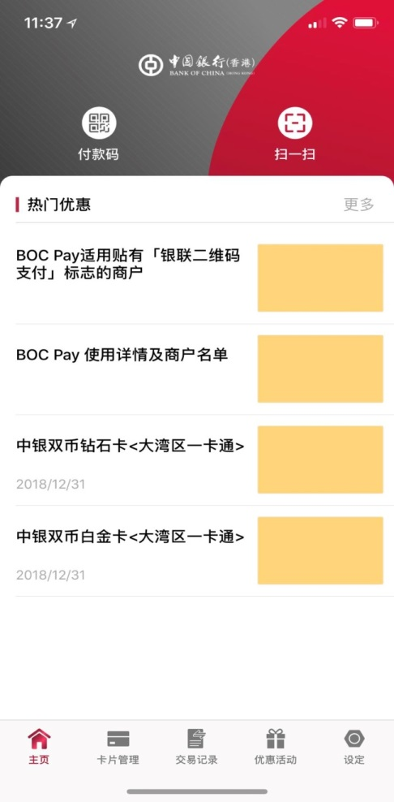
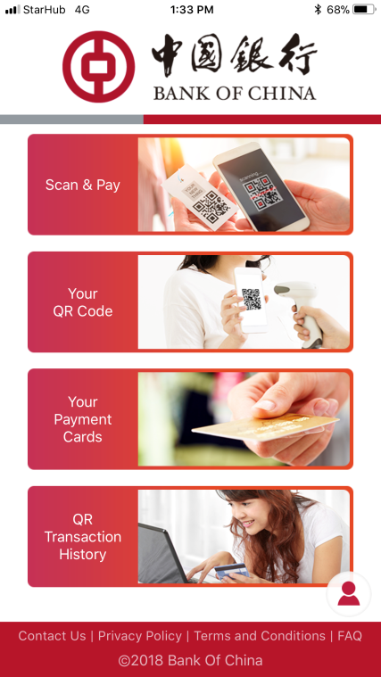
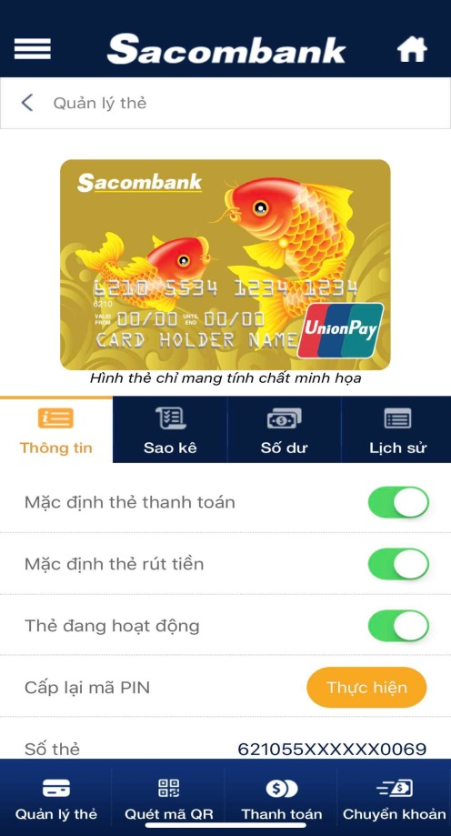

UnionPay QR Code Wallet
23 QRC-based Wallets
Projects across HK and SEA
40+ projects in the progress across Asia-Pacific, Middle Asia, Middle East, and Africa
Notes:
HK: K&R Int, BOC Pay , Guangfa Bank, UnionPay APP
SG: BOC SG eWallet, BOC APP, NETS, SinoPay
Thailand: BBL
VT: SacomBank
Bangladesh: MTB
Nepal: SCT

